Slide 1


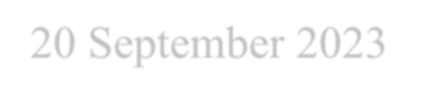


I Data Analytics Capstone Project
BM
RAMASONDRANO Andriamanjaka 20 September 2023
GitHub:
https://github.com/andriamanjakaramasondrano/IB M_Data_Analyst_Certificat_Professionnel

Slide 2

OUTLINE
Executive Summary
Introduction
Methodology
Results
Visualization – Charts
Dashboard
Discussion
Findings & Implications
Conclusion
Appendix

Slide 3

EXECUTIVE SUMMARY
Current Technology Usage
Top 10 Languages Worked with Top 10 Database Worked with Platform worked with Word-Cloud
Top 10 Web-frame Worked with
Future Technology Trend
Top 10 Languages Desired Next Year Top 10 Database Desired Next Year
Platform worked with Desired Next Year
Top 10 Web-frame Desired Next Year
Demographics
Respondents Classified by Gender Respondent Count for Countries Respondent Count by Age
Respondent Count by Gender by Formal Education Level

Slide 4

INTRODUCTION
This presentation has been crated for stakeholders and business decision makers within the global IT and business consulting services firm.
The presentation will help identify future skill requirements in the global IT sector necessarry for the firm to keep pace with changing technologies and remain competitive.
Recommendations will be stated based on the analysis.

Slide 5

METHODOLOGY
Collecting Data
Using – API.
Using – Web-scrapping.
Exploring Data
Finding Duplicates & Removing Duplicates.
Finding & Imputing Missing Value.
Normalizing Data.
Handling Outliers.
Correlation
Visualization Data
Visualization Distribution, Relation, Composition & Comparison of data.
Building Dashboard.

Slide 6
RESULTS

Slide 7
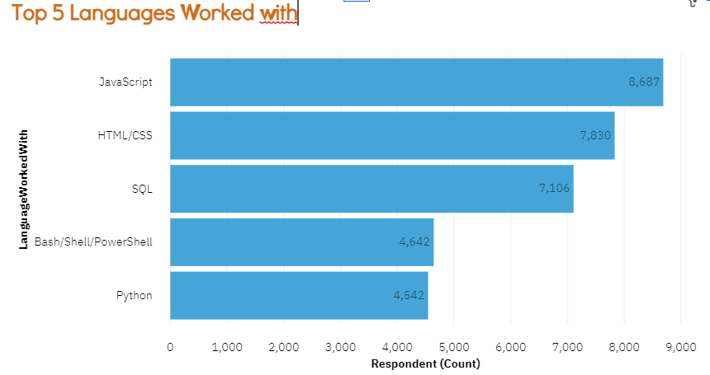
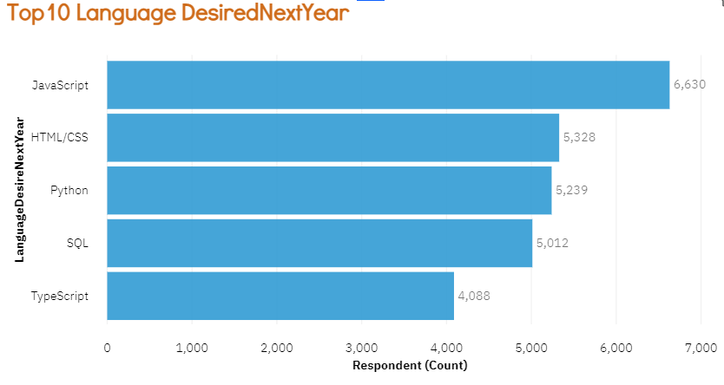
PROGRAMMING LANGUAGE TRENDS
Current Year Next Year
<Bar chart of top 5 programming languages for the current year goes here.>
< Bar chart of top 5 programming languages for the next year goes here.>

Slide 8
PROGRAMMING LANGUAGE TRENDS - FINDINGS & IMPLICATIONS
Findings
Java-script appears to be popular choice for current as well future years.
Web Assembly comes as least popular for current years and VBA appears least choice for next year
Python and SQL appears to be evergreen mid popular choice for current and next year respectively
Implications
Java-script is becoming the new upcoming popular demanding programming language among users.
Web Assembly and VBA has been replaced by other programming languages at most places.
Python and SQL appears to be evergreen demand Programming languages.

Slide 9
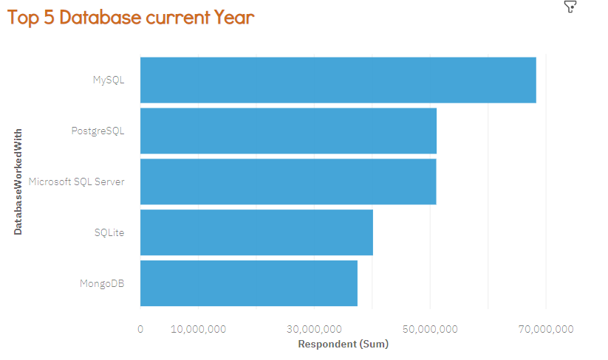
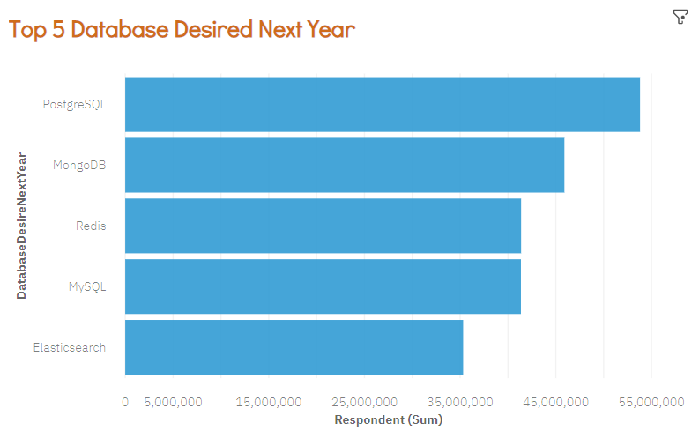
DATABASE TRENDS
Current Year
< Bar chart of top 5 databases for the current year goes here >
Next Year
< Bar chart of top 5 databases for the next year goes here.>

Slide 10
DATABASE TRENDS - FINDINGS & IMPLICATIONS
Findings Implications
MySQL comes out to be popular choice for current whereas PostgreSQL overcomes every other in case of desired next year choice.
Couchbase comes as least popular for current years as well as for next year as well.
Elasticsearch, Redis & MongoDB comes out to show progressive trends in upcoming years whereas MySQL shows declining trend as compared to current-next years charts.
PostgreSQL is becoming the new upcoming popular desired database skills among users replacing MySQL.
Couchbase has been replaced by other programming languages at most places.
Elasticsearch, Redis & MongoDB appears to be more popular desired choice as compared to MySQL.

Slide 11
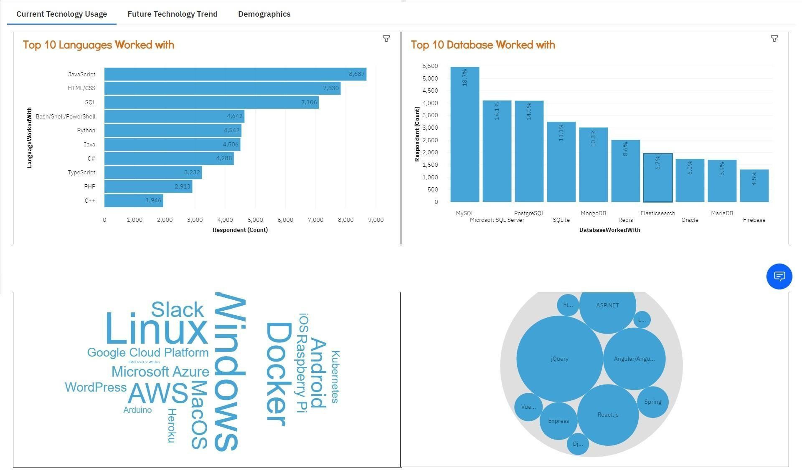
DASHBOARD TAB 1
Screenshot of dashboard tab 1 goes here

Slide 12
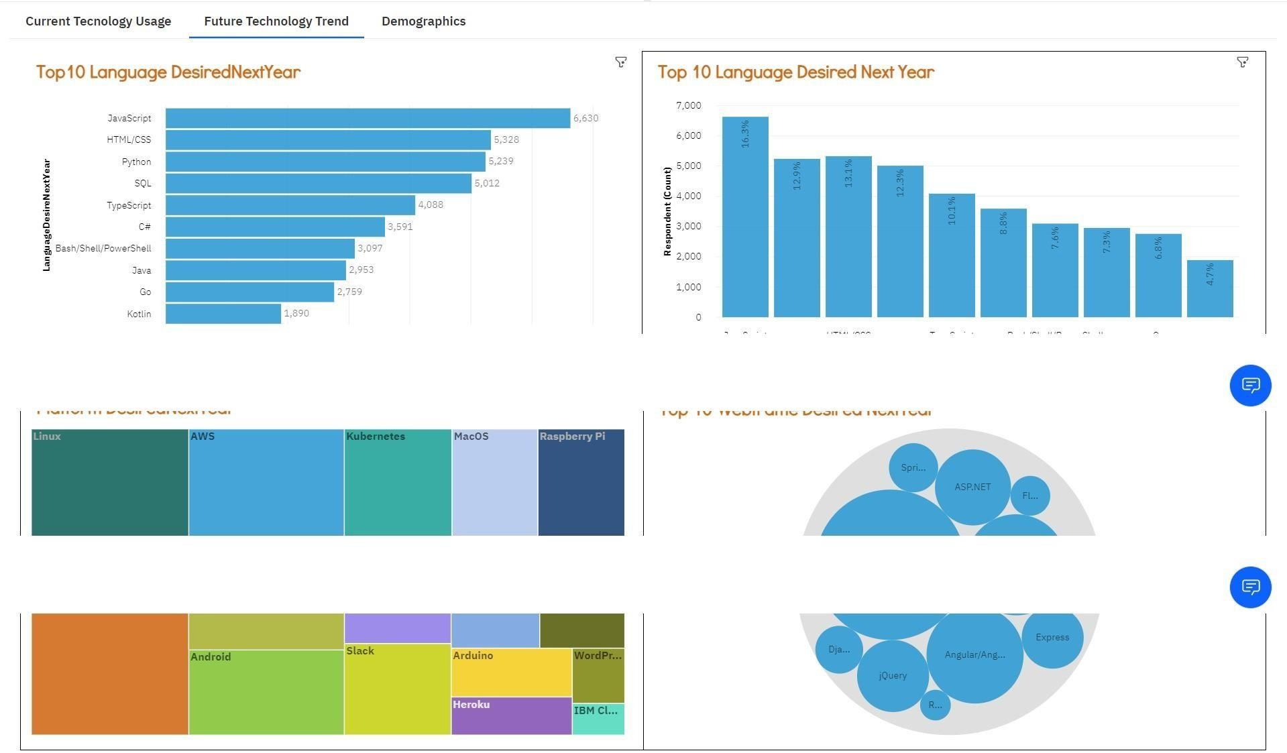
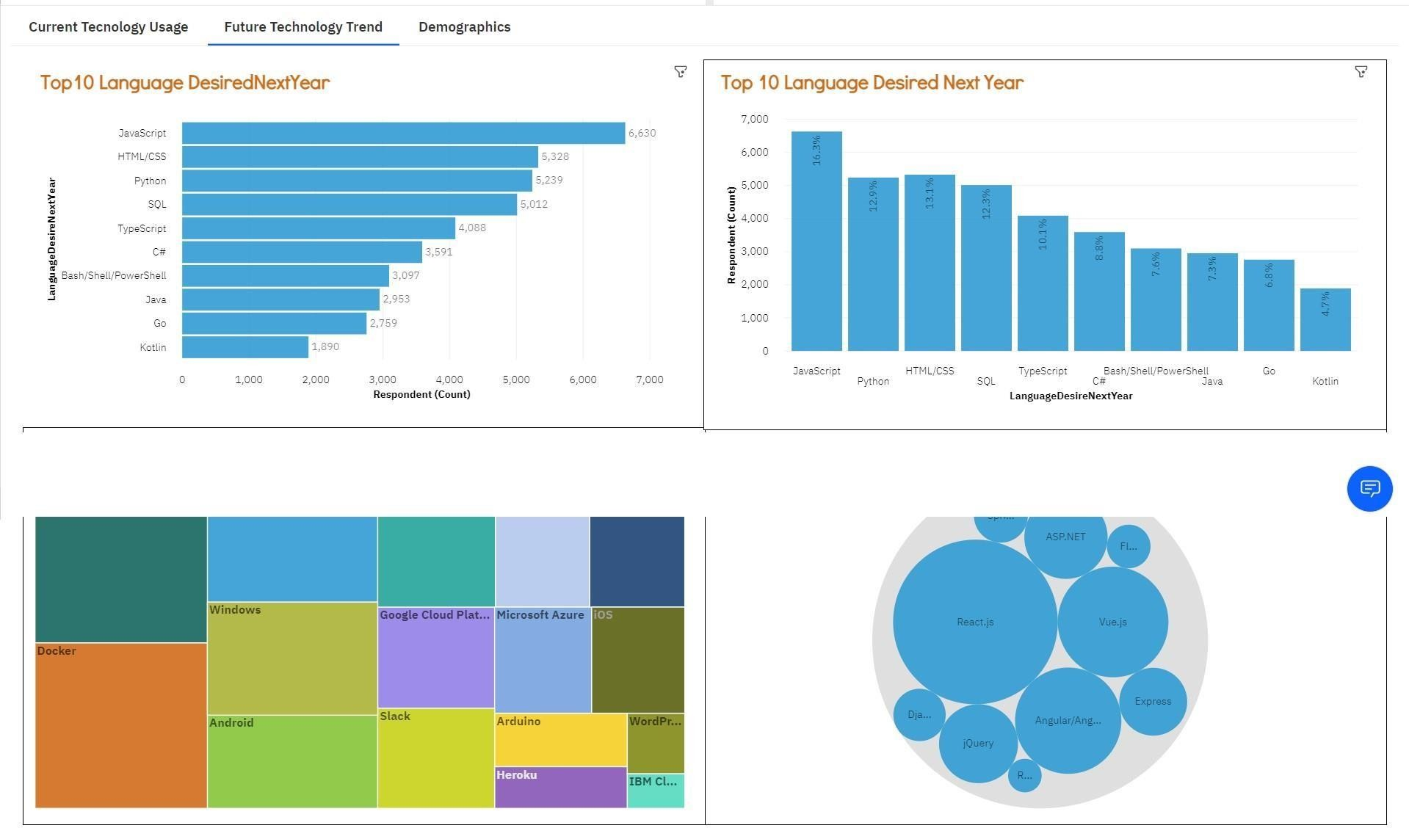
DASHBOARD TAB 2
Screenshot of dashboard tab 2 goes here

Slide 13
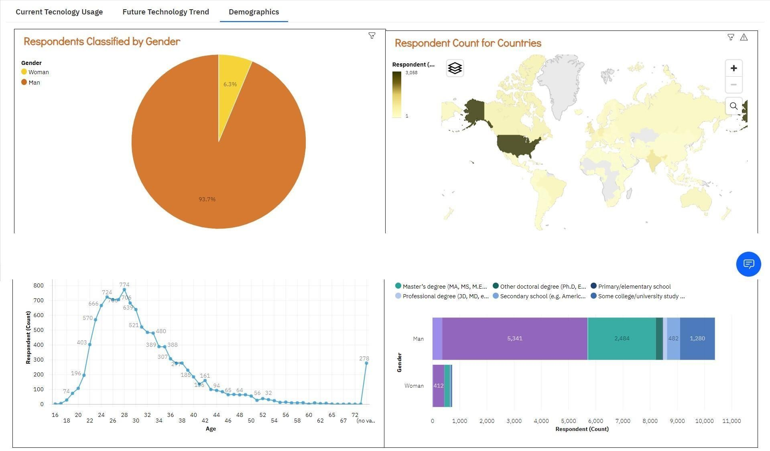
DASHBOARD TAB 3
Screenshot of dashboard tab 3 goes here

Slide 14

DISCUSSION
All age used for survey
All gender considered for survey.
People from different countries were asked for survey.
Various education level people were included as well.

Slide 15
OVERALL FINDINGS & IMPLICATIONS
Findings Implications
The upcoming programming trend is for advanced programming languages.
The upcoming trend for databases is non-relational databases mostly.
People are looking for advanced programming languages with easy learning in focus.
People are looking for big data because it seem to have great future.

Slide 16

CONCLUSION
The top programming language in demand Present & Future- Java-script.
The top database skills in demand Present – MySQL ; Future – PostgreSQL.
Popular Platform
Present – Windows ; Future – Linux Docker
The top Web-frame in Demand Present – jQuery ; Future – React.js

Slide 17
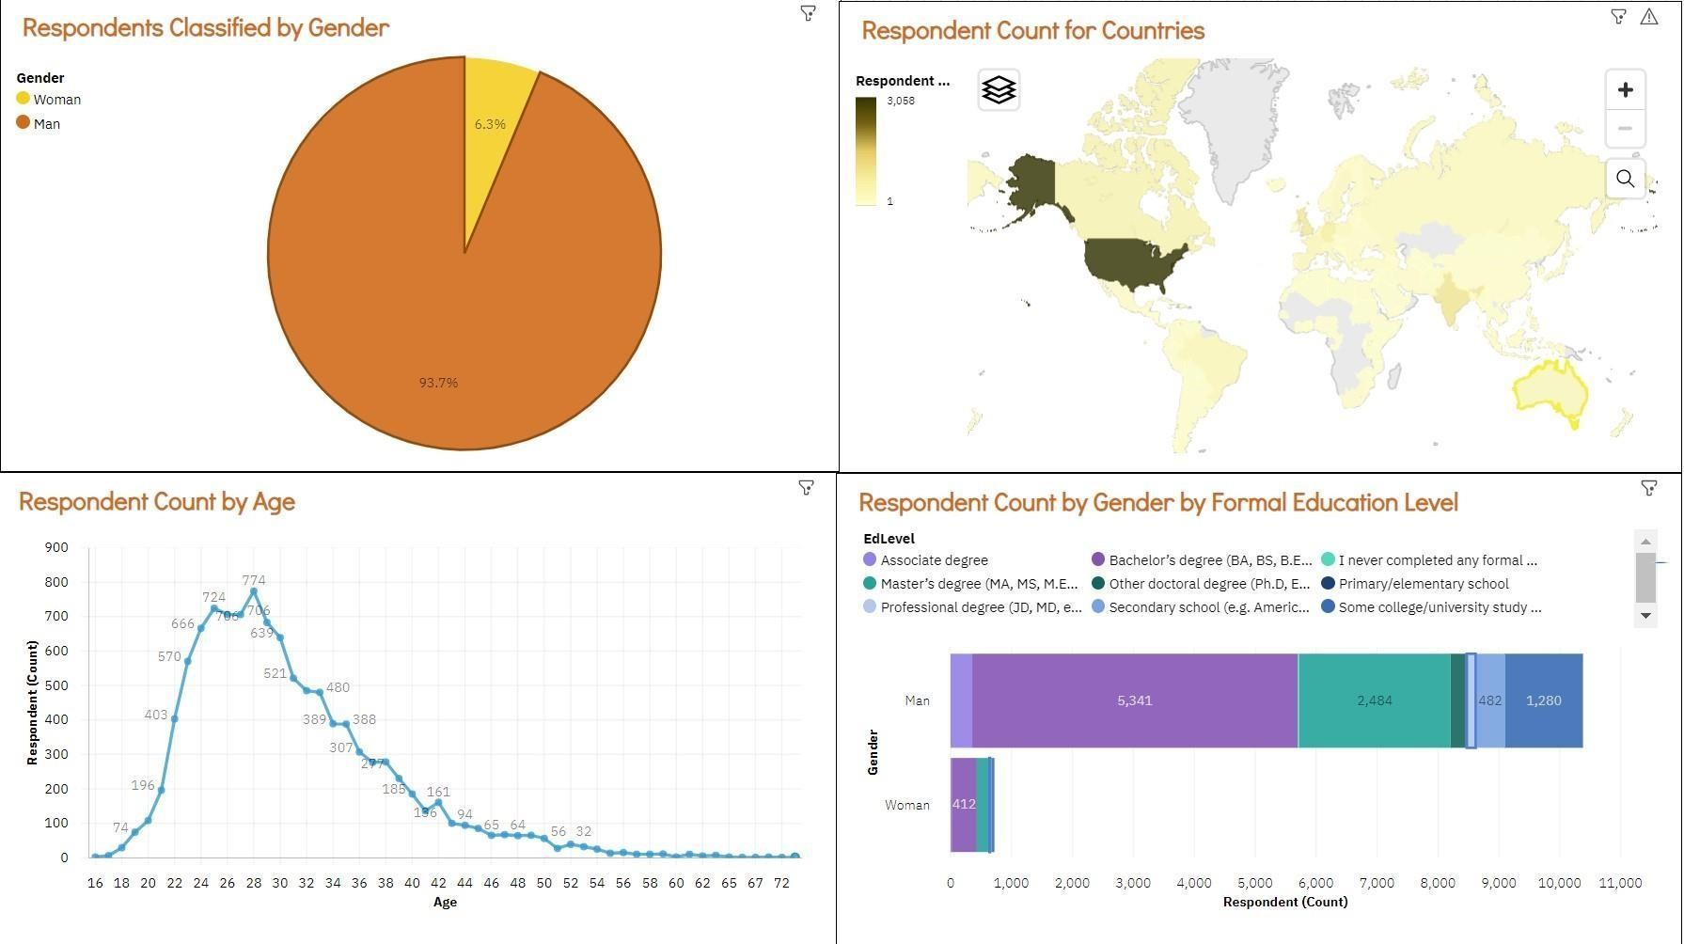

APPENDIX
Include any relevant additional charts, or tables that you may have created during the analysis phase.

Slide 18












Po•t •*es
horizoncal Dar of r›urr›ber
⁰•*
0
V
100
mm ber of jab pasLinp
_{Devc1ope*"}HUB JOB POSTINGS
l7s
0

Slide 19



POPULAR
LANGUAG
v
IBM Developer
SKILLS NITHORK

